Slide 1
Learning to @Test Drive
A Crash Course in Test Driven Development

Slide 2

@Before: Establish Goals
Basic Goals of This Talk
What is TDD?
Why TDD?
How to TDD?
Have some fun!
Notes:
• Why do we test? How do we test our code?
System.out.println
Debugging
main methods
Refresh your browser (again, and again)
SQL queries
Manual inspection of files
• Is this easy or difficult? Why?
This is time consuming and and difficult to reproduce. It’s all manual!
• What if we didn’t test our code?
We wouldn’t know it actually worked. We wouldn’t get paid!
• What happens when we have to modify existing code?
You have to re-test everything.
Talk to the QA guys, ask them for the testing spec, and re-do all the manual testing.
You have to do this every time you introduce a change into the system (that sucks!)

Slide 3
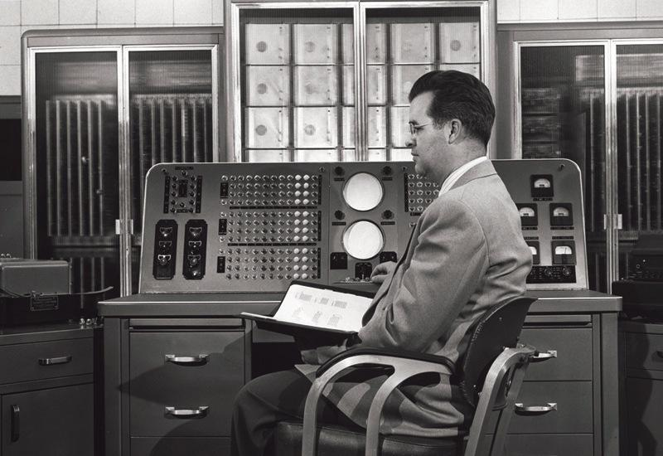
First of All – Testing Basics: What We Do Now
Why do we test?
To make sure it works, right?
How do we test our code?
System.out.println();
Debugging tools
Main methods
Refresh your browser
SQL queries
Manual inspection of files
Ask a QA guy to do it?
What do all these have
in common?
It’s Manual
Notes:
• Why do we test? How do we test our code?
System.out.println
Debugging
main methods
Refresh your browser (again, and again)
SQL queries
Manual inspection of files
• Is this easy or difficult? Why?
This is time consuming and and difficult to reproduce. It’s all manual!
• What if we didn’t test our code?
We wouldn’t know it actually worked. We wouldn’t get paid!
• What happens when we have to modify existing code?
You have to re-test everything.
Talk to the QA guys, ask them for the testing spec, and re-do all the manual testing.
You have to do this every time you introduce a change into the system (that sucks!)

Slide 4

First of All – Testing Basics:
Manual Testing Sucks!
Manual testing is hard!
Why?
Time consuming
Difficult to reproduce tests
Requires documentation
You have to remember
We’d rather be coding
What can we do?
Invent some magic button that records your testing and allows you to re-run them anytime you want?
Notes:
• Is this easy or difficult? Why?
This is time consuming and and difficult to reproduce. It’s all manual!
• What if we didn’t test our code?
We wouldn’t know it actually worked. We wouldn’t get paid!
• What happens when we have to modify existing code?
You have to re-test everything.
Talk to the QA guys, ask them for the testing spec, and re-do all the manual testing.
You have to do this every time you introduce a change into the system (that sucks!)

Slide 5

First of All – Testing Basics:
Introduce a Testing Framework
I’d like to introduce you Testing Frameworks
What does a testing framework allow us to do?
A Few Frameworks
Java & JUnit
JavaScript & Jasmine
Ruby & RSpec
More here: http://en.wikipedia.org/wiki/List_of_unit_testing_frameworks
Notes:
Anatomy of the Unit Testing Framework - 3 minutes
• What does a testing framework allow us to do?

Slide 6

First of All – Testing Basics:
Introduce a Testing Framework
Automate the testing we used to do manually (thats awesome!)
We use frameworks to help
us “setup” our code
We use frameworks to
“execute” our code
We use frameworks to
make “assertions”
Remember the “SEA”
Setup
Execute
Assert
Notes:
Automate the shit we used to do manually (thats awesome!)
• Setup (test fixtures), Execution, Assertions, Feedback.
We need frameworks to help us “setup” the code… check
We need frameworks to “execute” our code… check
We need frameworks to allow us to make “assertions” after execution… check
• Remember the “SEA”

Slide 7

Secondly – Now for some action:
Test First (Test Driven) vs. Test After
What’s the Difference?
To make a long story short:
According to Rod*, Test-Driven Development
showed the following improvements over
code written using the test-last technique.
Overall improvement of 21%
Decreasing the complexity of the code,
with an improvement of 31%
Cohesion improved by 21%.
The smallest improvement was on coupling metrics, only 10%.
*Rod Hilton, Quantitatively Evaluating Test-Driven Development by Applying Object-Oriented Quality Metrics to Open Source Projects
Notes:
Introduce Test-Driven Development and contrast it with the traditional test-last approach. Discuss the
benefits and process of TDD and how it can lead to better overall design and simplicity. Topics include:
See: Thesis Conclusions
Rod Hilton
Quantitatively Evaluating Test-Driven Development by Applying Object-Oriented Quality Metrics to Open Source Projects
Department of Computer & Information Sciences Regis University

Slide 8

Secondly – Now for some action:T
Test First (Test Driven) vs. Test After
If you test after you still have the “Safety Net” right?
Test-after can have coverage gaps.
All tests are NOT created equal.
Let’s talk about “Code Coverage.”
Notes:
• If I test after I still have the “safety net” right? Let’s talk about test coverage.
Gaps in coverage mean gaps in the net.
• Do you think your design and implementation will be the same?
Why do you think complexity was decreased by 31%?
TDD forces you to think smaller and simpler
TDD allows you to refactor fearlessly (we will get to that in a minute)
Why improvement in cohesion and coupling?
Recall that cohesion is essentially a measure of how related all of the responsibilities of a module are. Instead of writing big classes with many lines of code, TDD encourages developers to write simple and small classes, and use the power of object orientation mechanisms to put all the classes together.
In regards to the 10% reduction in coupling. In order to test, TDD encourages developers to follow some good object orientation principles: classes explicit their dependencies, and therefore become opened for extensions; coupling usually tend to be to high-level stable interfaces, reducing the risk of a modiﬁcation caused by changes in any dependency.
See: How Test-Driven Development Inﬂuences Class Design: A Practitioner’s Point of View, Mauricio Finavaro Aniche, Marco Aurelio Gerosa. http://www.ime.usp.br/~aniche/files/tdd-and-design-draft.pdf

Slide 9

Secondly – Now for some action:T
Test First (Test Driven) vs. Test After
Coverage Example
Notes:
Introduce Test-Driven Development and contrast it with the traditional test-last approach. Discuss the
benefits and process of TDD and how it can lead to better overall design and simplicity. Topics include:
Test First (Test Driven) vs. Test After - 5 minutes
• What’s the difference? See: Thesis Conclusions
To make a long story short:
Test-Driven Development offered an overall improvement of 21% over code written using the test-last technique.
Test-Driven Development was most effective at decreasing the complexity of the code, with an improvement of 31%.
The next-best improvement was on cohesion metrics, an improvement of 21%.
The smallest improvement Test-Driven Development offered was on coupling metrics, only 10%. Miller (2008) explains that tight coupling means that modules and subsystems must know the details of other modules and subsystems in order to function. This means that, for tightly coupled systems, in order to write tests that verify whether a module or subsystem functions correctly, the test must also involve the details of other modules and subsystems. Essentially, tests become harder and harder to write the more tightly coupled the different parts of the system are. As explained by Tate and Gehtland (2004), the best defense against high system coupling is writing tests.
• If I test after I still have the “safety net” right? Let’s talk about test coverage.
Gaps in coverage mean gaps in the net.
• Do you think your design and implementation will be the same?
Why do you think complexity was decreased by 31%?
TDD forces you to think smaller and simpler
TDD allows you to refactor fearlessly (we will get to that in a minute)
Why improvement in cohesion and coupling?
Recall that cohesion is essentially a measure of how related all of the responsibilities of a module are. Instead of writing big classes with many lines of code, TDD encourages developers to write simple and small classes, and use the power of object orientation mechanisms to put all the classes together.
In regards to the 10% reduction in coupling. In order to test, TDD encourages developers to follow some good object orientation principles: classes explicit their dependencies, and therefore become opened for extensions; coupling usually tend to be to high-level stable interfaces, reducing the risk of a modiﬁcation caused by changes in any dependency.
See: How Test-Driven Development Inﬂuences Class Design: A Practitioner’s Point of View, Mauricio Finavaro Aniche, Marco Aurelio Gerosa. http://www.ime.usp.br/~aniche/files/tdd-and-design-draft.pdf

Slide 10
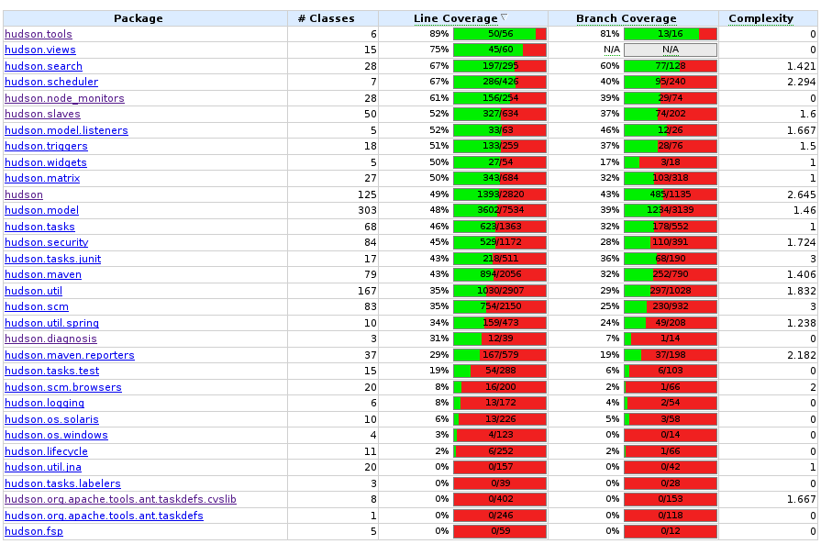
Secondly – Now for some action:T
Test First (Test Driven) vs. Test After
Code Coverage Example
Notes:
Introduce Test-Driven Development and contrast it with the traditional test-last approach. Discuss the
benefits and process of TDD and how it can lead to better overall design and simplicity. Topics include:
Test First (Test Driven) vs. Test After - 5 minutes
• What’s the difference? See: Thesis Conclusions
To make a long story short:
Test-Driven Development offered an overall improvement of 21% over code written using the test-last technique.
Test-Driven Development was most effective at decreasing the complexity of the code, with an improvement of 31%.
The next-best improvement was on cohesion metrics, an improvement of 21%.
The smallest improvement Test-Driven Development offered was on coupling metrics, only 10%. Miller (2008) explains that tight coupling means that modules and subsystems must know the details of other modules and subsystems in order to function. This means that, for tightly coupled systems, in order to write tests that verify whether a module or subsystem functions correctly, the test must also involve the details of other modules and subsystems. Essentially, tests become harder and harder to write the more tightly coupled the different parts of the system are. As explained by Tate and Gehtland (2004), the best defense against high system coupling is writing tests.
• If I test after I still have the “safety net” right? Let’s talk about test coverage.
Gaps in coverage mean gaps in the net.
• Do you think your design and implementation will be the same?
Why do you think complexity was decreased by 31%?
TDD forces you to think smaller and simpler
TDD allows you to refactor fearlessly (we will get to that in a minute)
Why improvement in cohesion and coupling?
Recall that cohesion is essentially a measure of how related all of the responsibilities of a module are. Instead of writing big classes with many lines of code, TDD encourages developers to write simple and small classes, and use the power of object orientation mechanisms to put all the classes together.
In regards to the 10% reduction in coupling. In order to test, TDD encourages developers to follow some good object orientation principles: classes explicit their dependencies, and therefore become opened for extensions; coupling usually tend to be to high-level stable interfaces, reducing the risk of a modiﬁcation caused by changes in any dependency.
See: How Test-Driven Development Inﬂuences Class Design: A Practitioner’s Point of View, Mauricio Finavaro Aniche, Marco Aurelio Gerosa. http://www.ime.usp.br/~aniche/files/tdd-and-design-draft.pdf

Slide 11

Secondly – Now for some action:T
Test First (Test Driven) vs. Test After
Gaps in Code Coverage
Writing code that isn’t
tested causes gaps
(holes in your safety net).
Notes:
• Do you think your design and implementation will be the same?
Why do you think complexity was decreased by 31%?
TDD forces you to think smaller and simpler
TDD allows you to refactor fearlessly (we will get to that in a minute)
Why improvement in cohesion and coupling?
Recall that cohesion is essentially a measure of how related all of the responsibilities of a module are. Instead of writing big classes with many lines of code, TDD encourages developers to write simple and small classes, and use the power of object orientation mechanisms to put all the classes together.
In regards to the 10% reduction in coupling. In order to test, TDD encourages developers to follow some good object orientation principles: classes explicit their dependencies, and therefore become opened for extensions; coupling usually tend to be to high-level stable interfaces, reducing the risk of a modiﬁcation caused by changes in any dependency.
See: How Test-Driven Development Inﬂuences Class Design: A Practitioner’s Point of View, Mauricio Finavaro Aniche, Marco Aurelio Gerosa. http://www.ime.usp.br/~aniche/files/tdd-and-design-draft.pdf

Slide 12
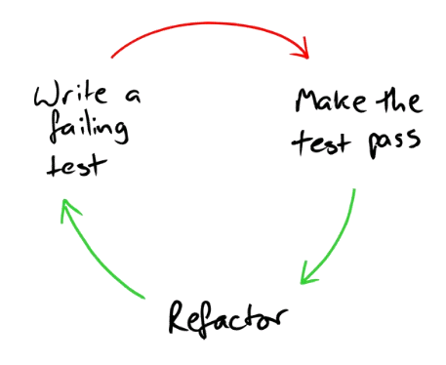
Secondly – Now for some action:
Drum Roll Please...
TDD Cadence: Red, Green, Refactor
Step 1: Write a failing test
Step 2: Write just enough code
to make the test pass
Step 3: Refactor your code
Continue this process until
you’re done.
Congratulations, you are now a
Test driver (here’s your license)
Notes:
And Now What You’ve All Been Waiting For - 10 minutes
TDD Cadence: Red, Green, Refactor - 5 minutes
• Step 1: Write a failing test
• Step 2: Write just enough code to make the test pass
• Step 3: Refactor or go back to Step 1
• Continue this process until you’re done.
• Congratulations, you are now a Test driver (here’s your license)
TDD influence on Design - 3 minutes
• Does this fit into the “Big Design Up Front ” that the Architects have approved?
• We still need to consider Design Up Front (just not so BIG)
• What is Coding by Intention?

Slide 13

Secondly – Now for some action:
Supporting Practices
Supporting Practices
Refactoring
Coding by Intention
Continuous Integration
Code Coverage Tools
Design Patterns
Testing Patterns
Notes:
Supporting Practices - 2 minutes
• Refactoring
• Continuous Integration (eg Jenkins)
• Code Coverage Tools (eg Clover)
• Design Patterns
• Testing Patterns

Slide 14
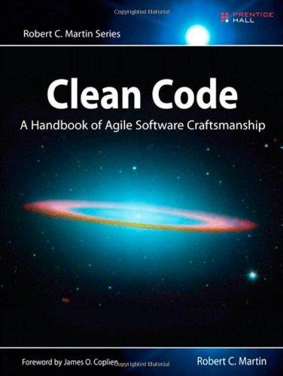
First of All – Testing Basics:
Homework
Recommended Reading
Martin, Robert C. Clean Code: A Handbook of Agile Software Craftsmanship
Clean Code Principles & Refactoring Concepts
1. Clean Code
2. Meaningful Names
3. Functions
4. Comments
5. Formatting
9. Unit Tests
Notes:
Recommended Reading
Clean Code Principles & Refactoring Concepts (Win a copy??)
• What does “Clean Code” mean?
• Read chapters 1-5 & 9 from Bob Martins Clean Code
1. Clean Code
2. Meaningful Names
3. Functions
4. Comments
5. Formatting
9. Unit Tests

Slide 15
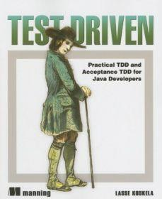
Secondly – Now for some action:
Homework
Recommended Reading
Koskela, Lasse Test Driven: TDD and Acceptance TDD for Java Developers
Part 1: A TDD Primer
Chapter 1: The Big Picture
Chapter 2: Beginning TDD
Notes:
Recommended Reading
Let’s do Some Reading (Win a copy??)
• Test Driven (Lasse Koskela)
Part 1: A TDD Primer
Chapter 1: The Big Picture
Chapter 2: Beginning TDD

Slide 16

Secondly – Now for some action: Time to Code (Finally!)
Fire Up Eclipse
Let’s work through the
String Calculator Kata
The following is a TDD Kata an exercise in coding, refactoring and test-first, that you should apply.
Before you start:
Try not to read ahead. Do one task at a time. The trick is to learn to work incrementally. Make sure you only test for correct inputs. there is no need to test for invalid inputs for this kata
Watch it: http://vimeo.com/8722480
Notes:
Let’s work through the Calculator Kata

Slide 17
Secondly – Now for some action: String Calculator Kata
1) Create a simple String calculator with a method int Add(string numbers) (10-15 minutes)
a) The method can take 0, 1 or 2 numbers, and will return their sum (for an empty string it will return 0) for example “” or “1” or “1,2”
b) Start with the simplest test case of an empty string and move to 1 and two numbers
c) Remember to solve things as simply as possible so that you force yourself to write tests
you did not think about
d) Remember to refactor after each passing test
2) Allow the Add method to handle an unknown amount of numbers (5-10 minutes)
3) Allow the Add method to handle new lines between numbers (instead of commas). (5-10 minutes)
a) the following input is ok: “1\n2,3” (will equal 6)
b) the following input is NOT ok: “1,\n” (not need to prove it - just clarifying)
4) Support different delimiters (10-15 minutes)
a) to change a delimiter, the beginning of the string will contain a separate line that looks like this: “//[delimiter]\n[numbers...]” for example “//;\n1;2” should return three where the default delimiter is ‘;’ .
b) the first line is optional. all existing scenarios should still be supported
5) Calling Add with a negative number will throw an exception “negatives not allowed” – (10 minutes)
and the negative that was passed. if there are multiple negatives, show all of them in the exception message
Notes:
Let’s work through the Calculator Kata

Slide 18

Questions:
Or more coding?
If there are any questions, we can answer them now, otherwise let’s code!
When in Rome, convert their numbers so we can understand them.
Roman Numeral Kata
Notes:
Let’s work through the Calculator Kata

Slide 19
Resources:
Continuous Learning
Below is a list of resources used to prepare the materials for this course.
Links:
http://a-developer-life.blogspot.com/2011/12/mocks-stubs-expectations-fakes-stubs.html
http://a-developer-life.blogspot.com/2011/06/jasmine-part-2-spies-and-mocks.html
https://github.com/tcorral/Refactoring_Patterns
Jasmine:
http://pivotal.github.io/jasmine/
https://github.com/velesin/jasmine-jquery
http://tobyho.com/2011/12/15/jasmine-spy-cheatsheet/
http://tryjasmine.com/
Katas:
http://www.peterprovost.org/blog/2012/05/02/kata-the-only-way-to-learn-tdd
String Calculator
http://anotherdave.wordpress.com/2010/01/13/calculator-tdd-kata-in-javascript/
http://vimeo.com/8708519
Roman Numerals
http://codingdojo.org/cgi-bin/wiki.pl?KataRomanNumerals
http://youtu.be/BAavcCsCEpA
Notes:
Let’s work through the Calculator Kata
Resources
Below is a list of resources used to prepare the materials for this course.
Links:
http://a-developer-life.blogspot.com/2011/12/mocks-stubs-expectations-fakes-stubs.html
http://a-developer-life.blogspot.com/2011/06/jasmine-part-2-spies-and-mocks.html
https://github.com/tcorral/Refactoring_Patterns
Jasmine
http://pivotal.github.io/jasmine/
https://github.com/velesin/jasmine-jquery
http://tobyho.com/2011/12/15/jasmine-spy-cheatsheet/
http://tryjasmine.com/
Katas:
http://www.peterprovost.org/blog/2012/05/02/kata-the-only-way-to-learn-tdd
FizzBuzz
http://codingdojo.org/cgi-bin/wiki.pl?KataFizzBuzz
http://www.youtube.com/watch?v=RQTDMk4WCp4&hd=1
String Calculator
http://anotherdave.wordpress.com/2010/01/13/calculator-tdd-kata-in-javascript/
http://vimeo.com/8708519
Roman Numerals
http://codingdojo.org/cgi-bin/wiki.pl?KataRomanNumerals
http://youtu.be/BAavcCsCEpA
BankOCR
http://codingdojo.org/cgi-bin/wiki.pl?KataBankOCR
https://code.google.com/p/danoncodekatas/wiki/KataBankOCRResources
Below is a list of resources used to prepare the materials for this course.
Links:
http://a-developer-life.blogspot.com/2011/12/mocks-stubs-expectations-fakes-stubs.html
http://a-developer-life.blogspot.com/2011/06/jasmine-part-2-spies-and-mocks.html
https://github.com/tcorral/Refactoring_Patterns
Jasmine
http://pivotal.github.io/jasmine/
https://github.com/velesin/jasmine-jquery
http://tobyho.com/2011/12/15/jasmine-spy-cheatsheet/
http://tryjasmine.com/
Katas:
http://www.peterprovost.org/blog/2012/05/02/kata-the-only-way-to-learn-tdd
FizzBuzz
http://codingdojo.org/cgi-bin/wiki.pl?KataFizzBuzz
http://www.youtube.com/watch?v=RQTDMk4WCp4&hd=1
String Calculator
http://anotherdave.wordpress.com/2010/01/13/calculator-tdd-kata-in-javascript/
http://vimeo.com/8708519
Roman Numerals
http://codingdojo.org/cgi-bin/wiki.pl?KataRomanNumerals
http://youtu.be/BAavcCsCEpA
BankOCR
http://codingdojo.org/cgi-bin/wiki.pl?KataBankOCR
https://code.google.com/p/danoncodekatas/wiki/KataBankOCR

